Slide 1
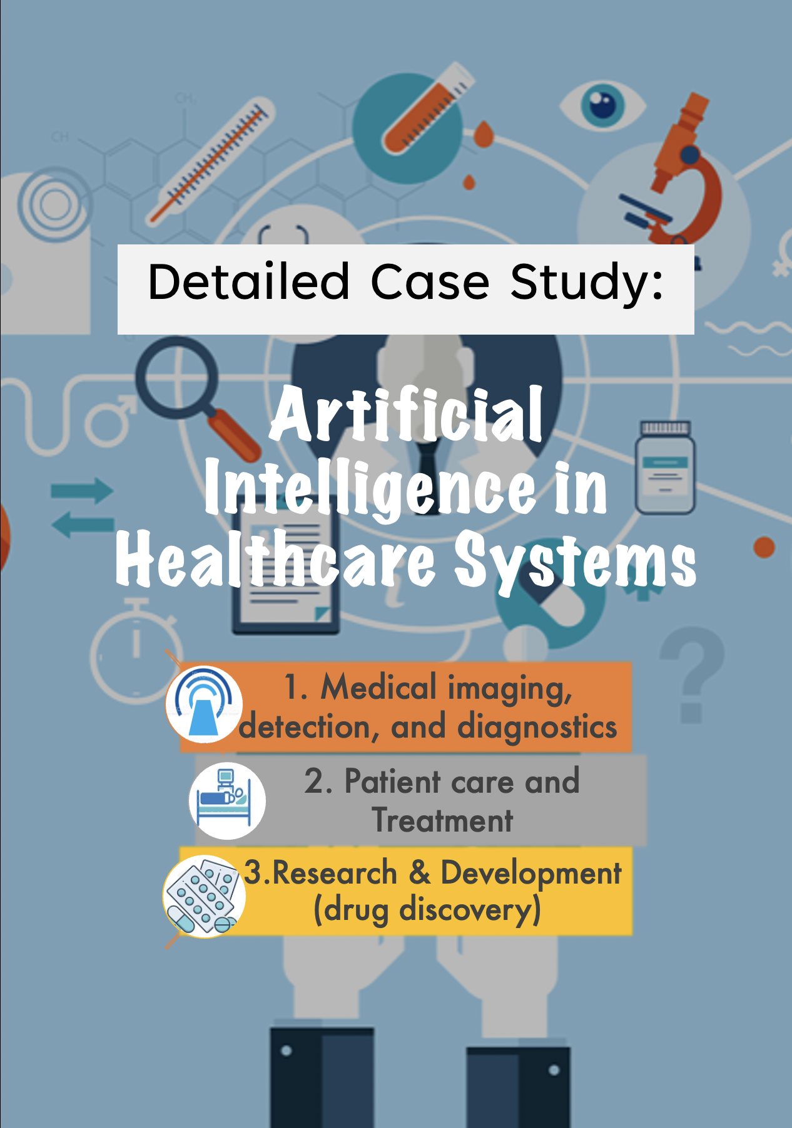

Slide 2
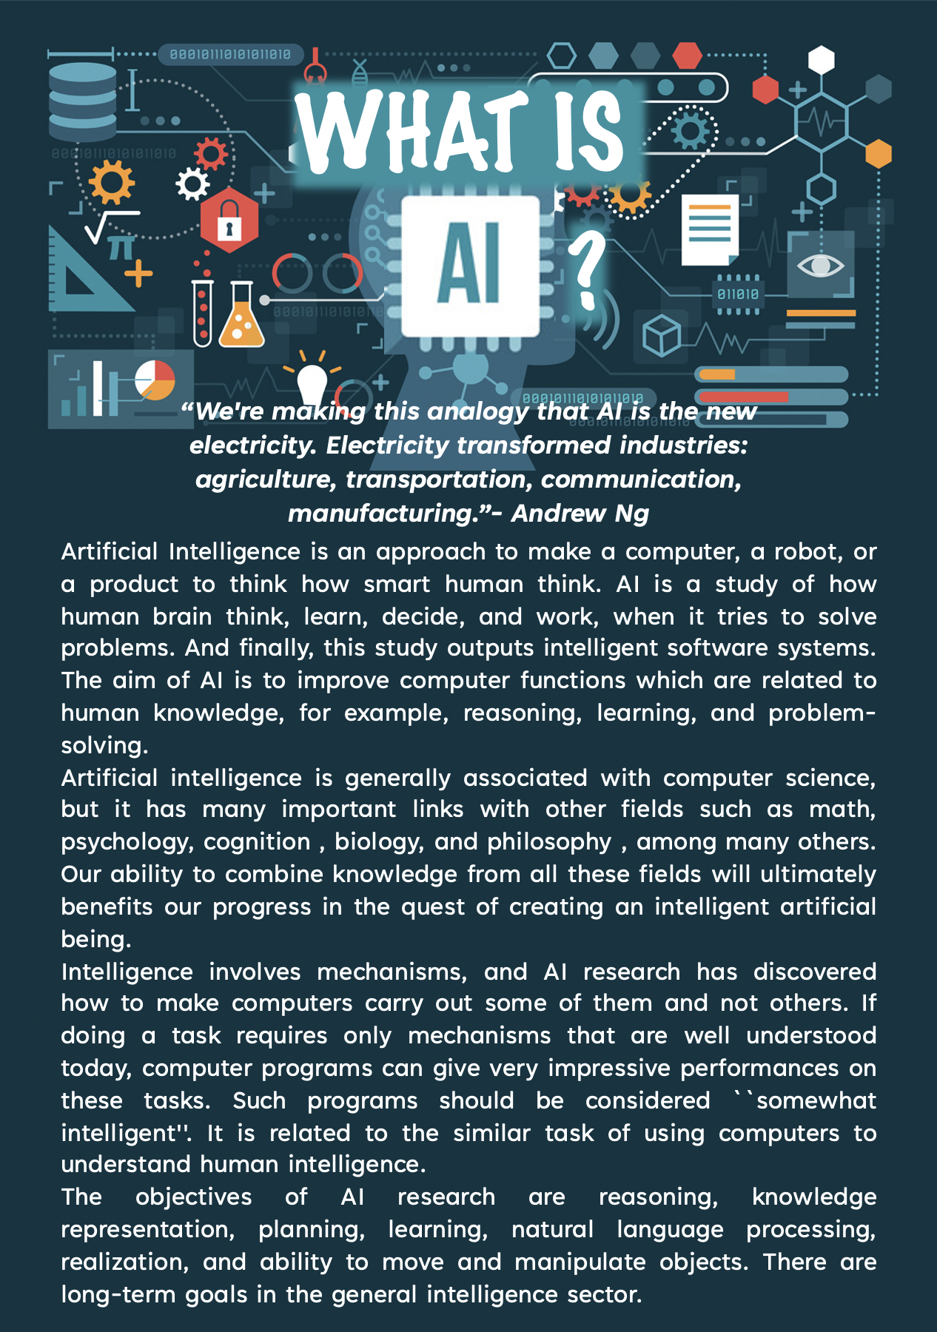

Slide 3
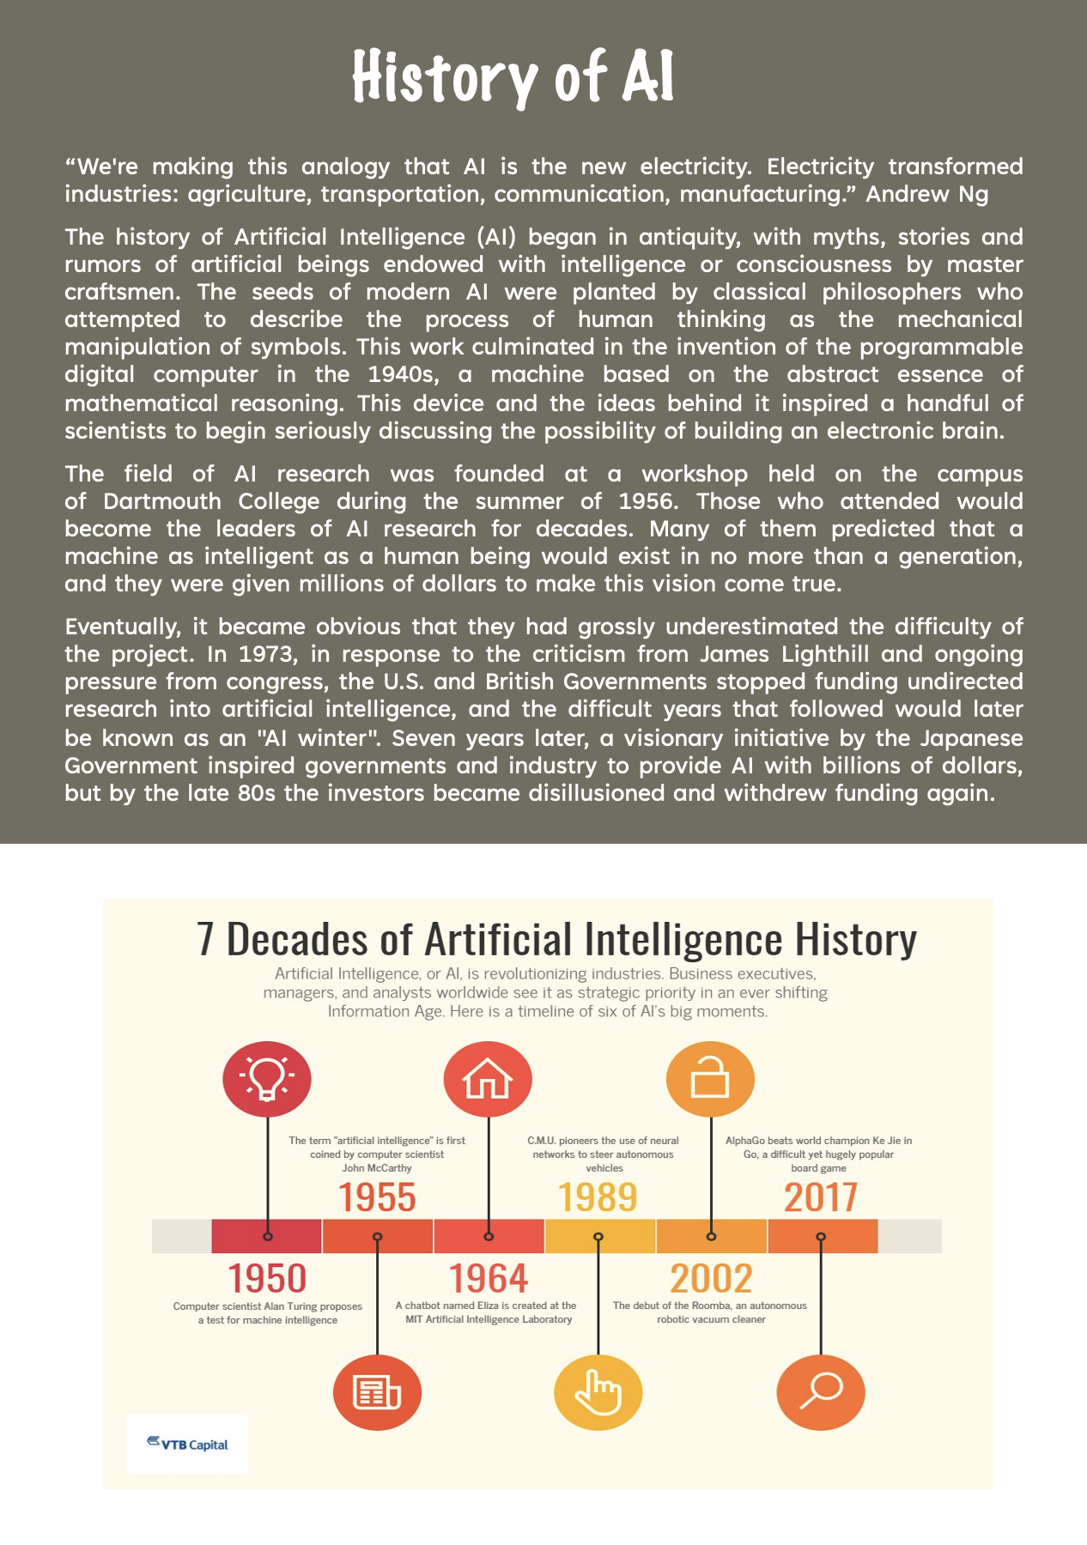

Slide 4
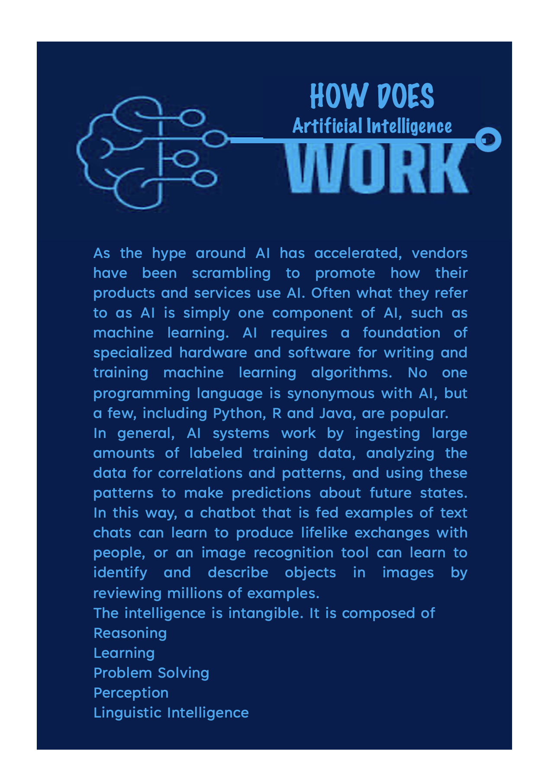

Slide 5
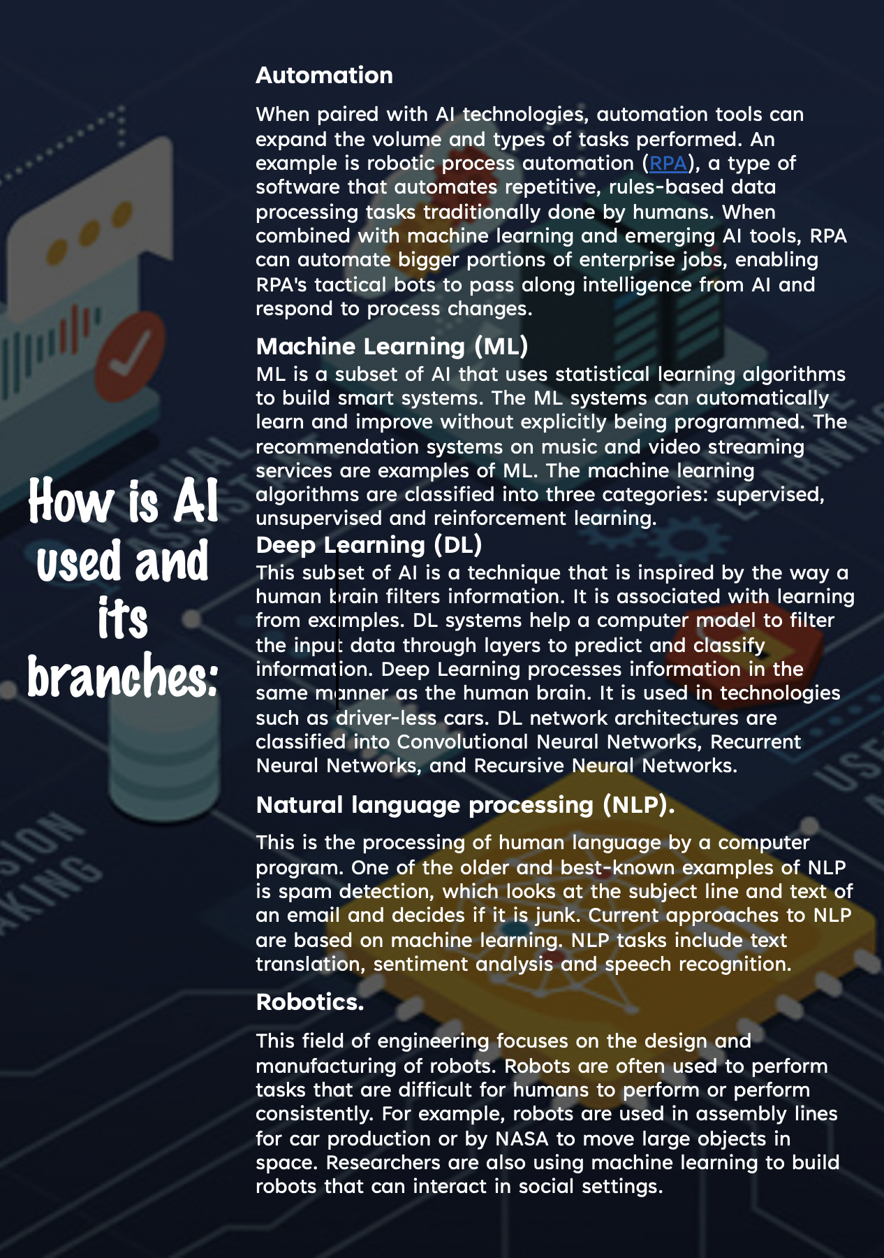

Slide 6
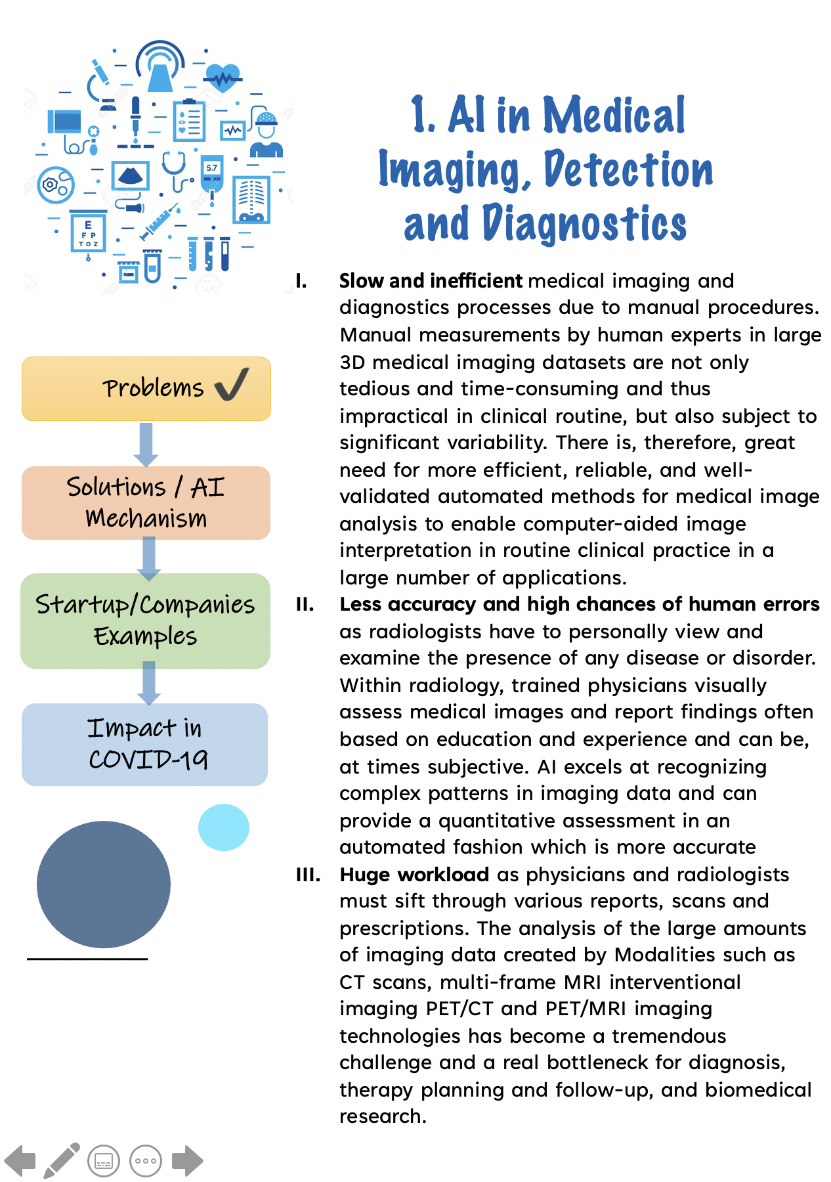

Slide 7
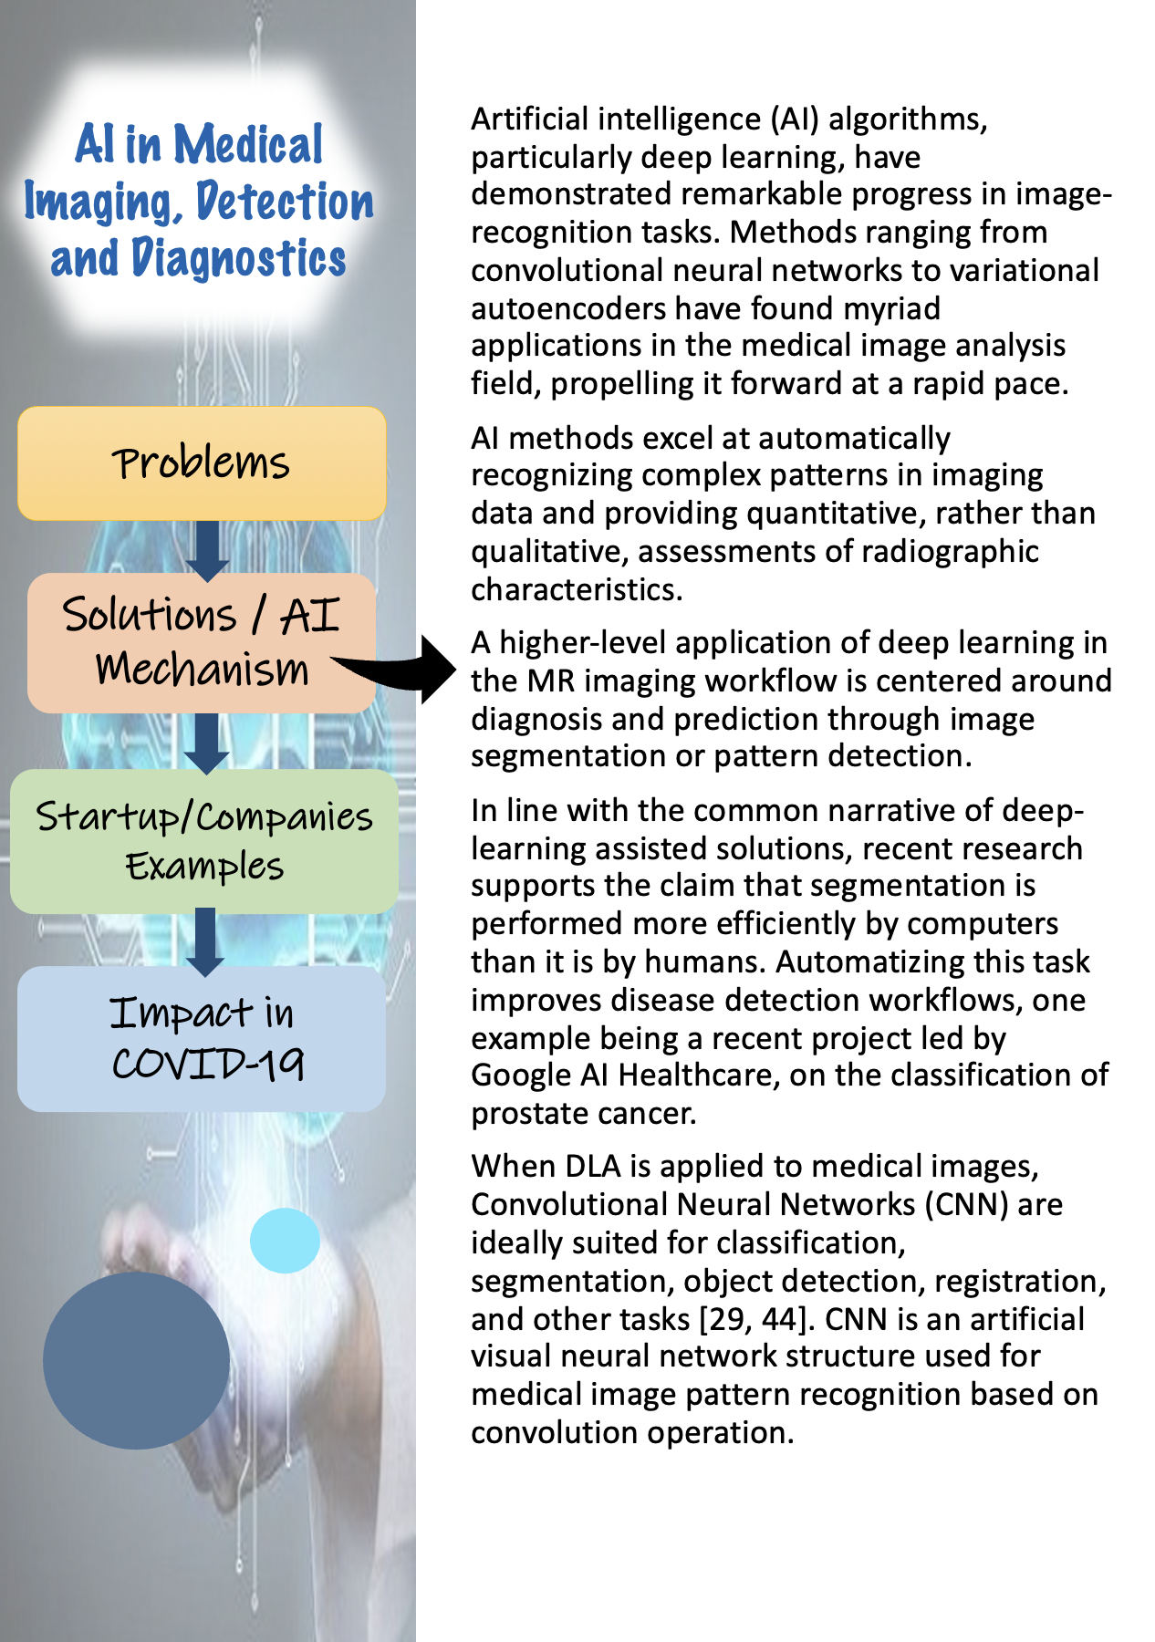

Slide 8
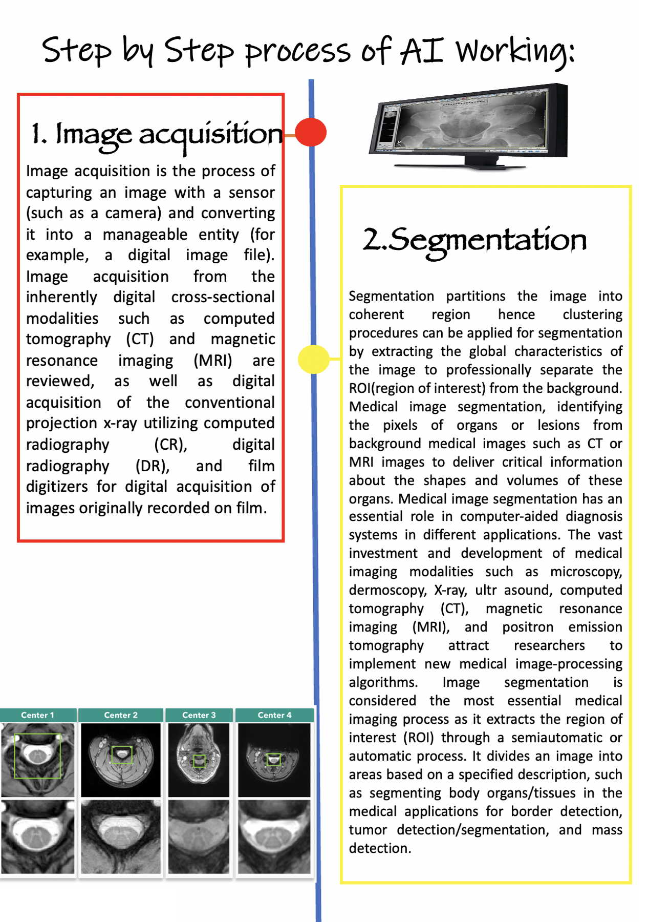

Slide 9
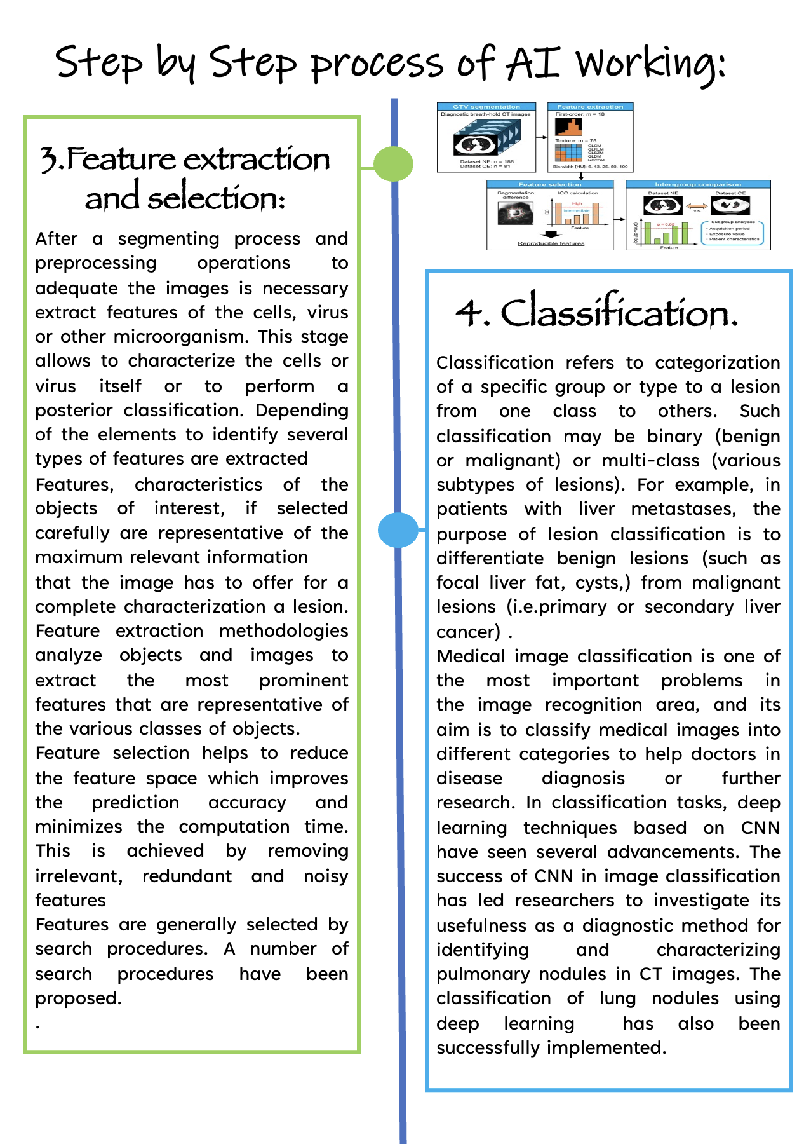

Slide 10
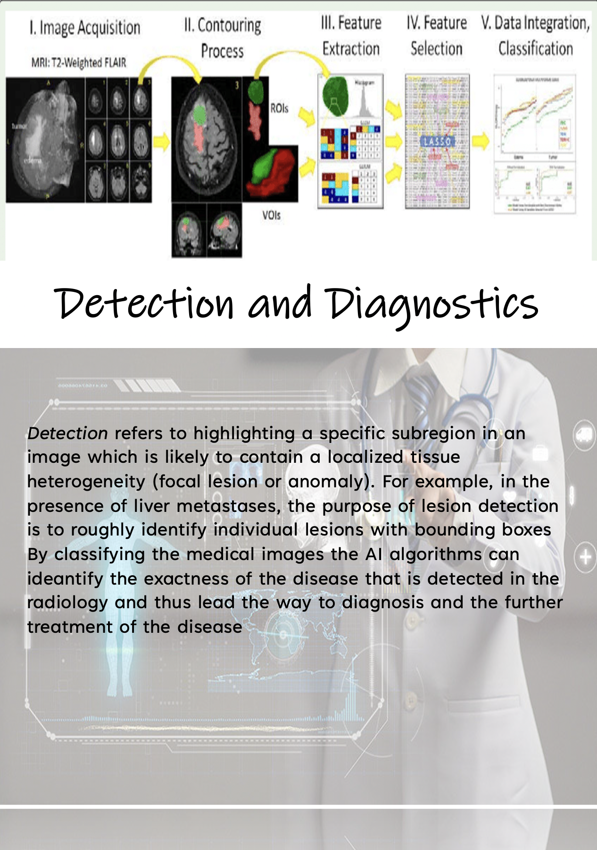

Slide 11
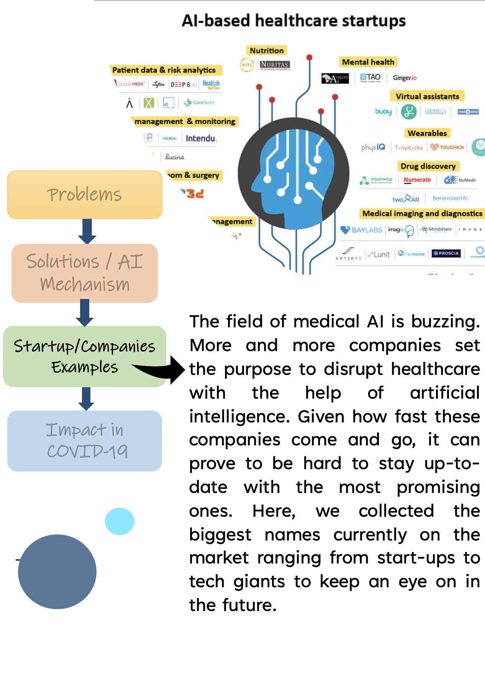

Slide 12
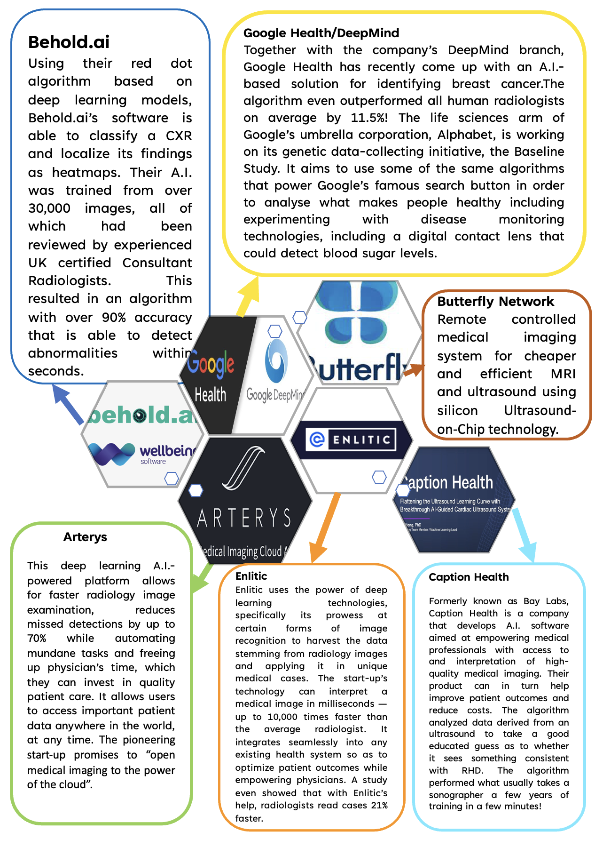

Slide 13
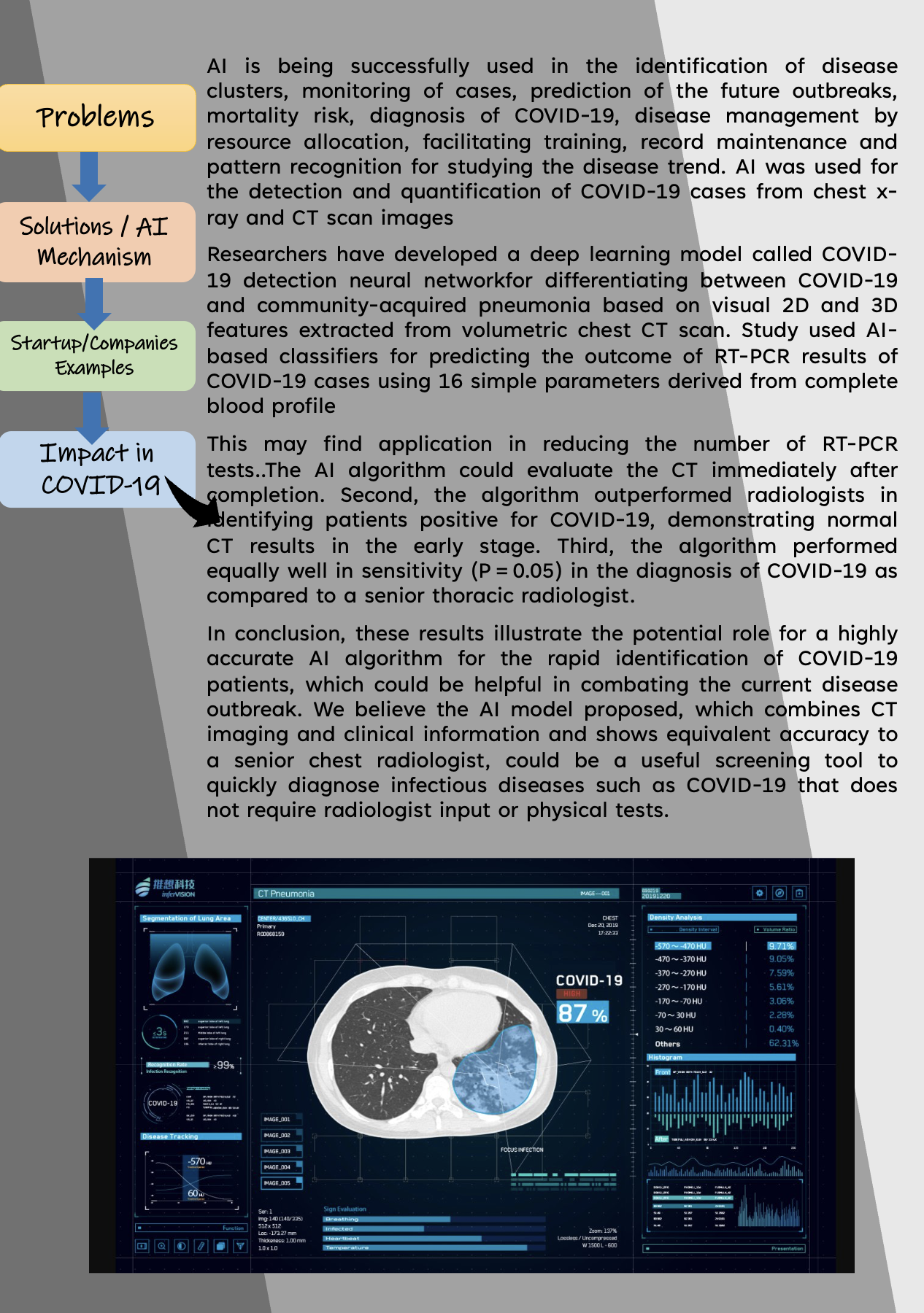

Slide 14
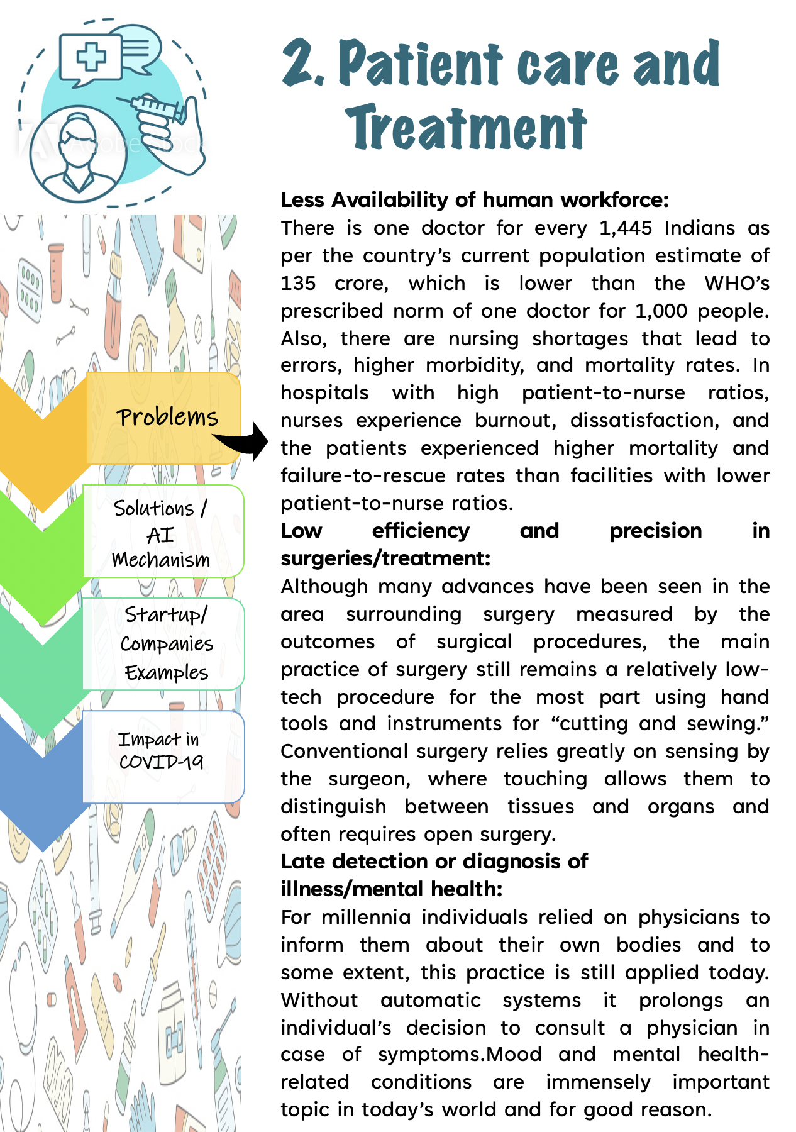

Slide 15
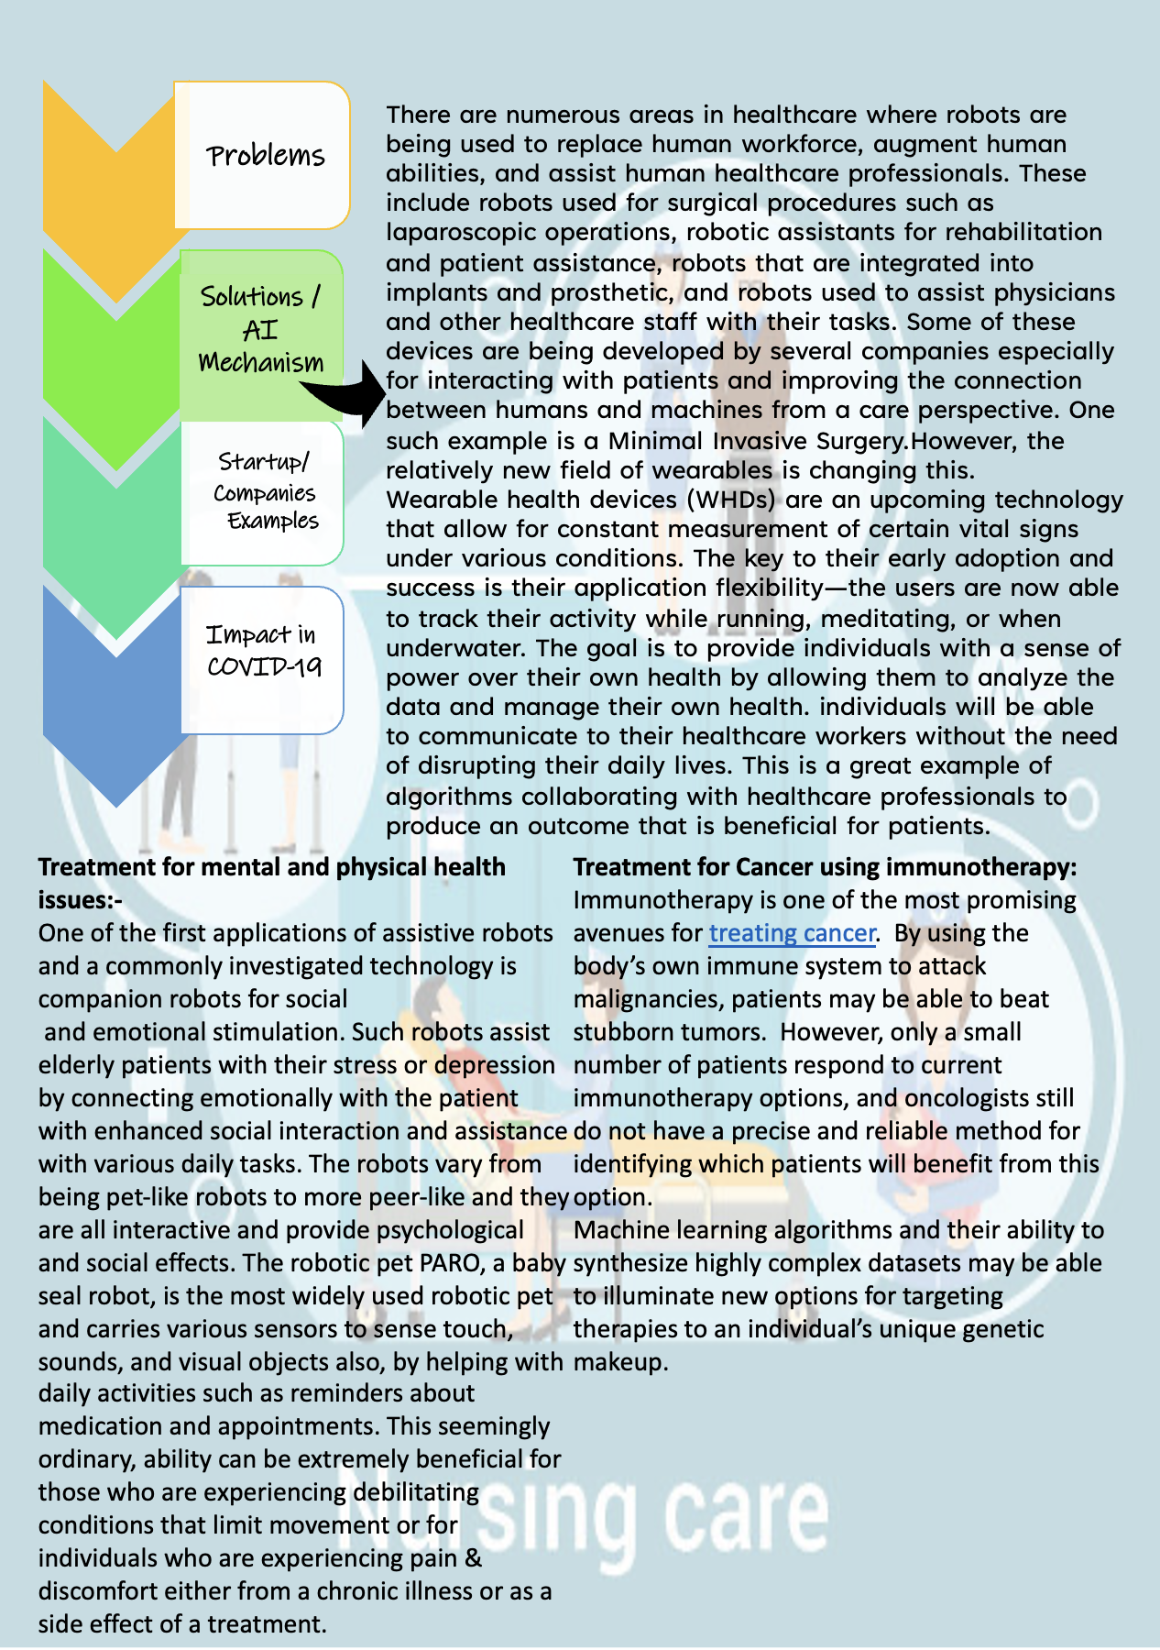

Slide 16
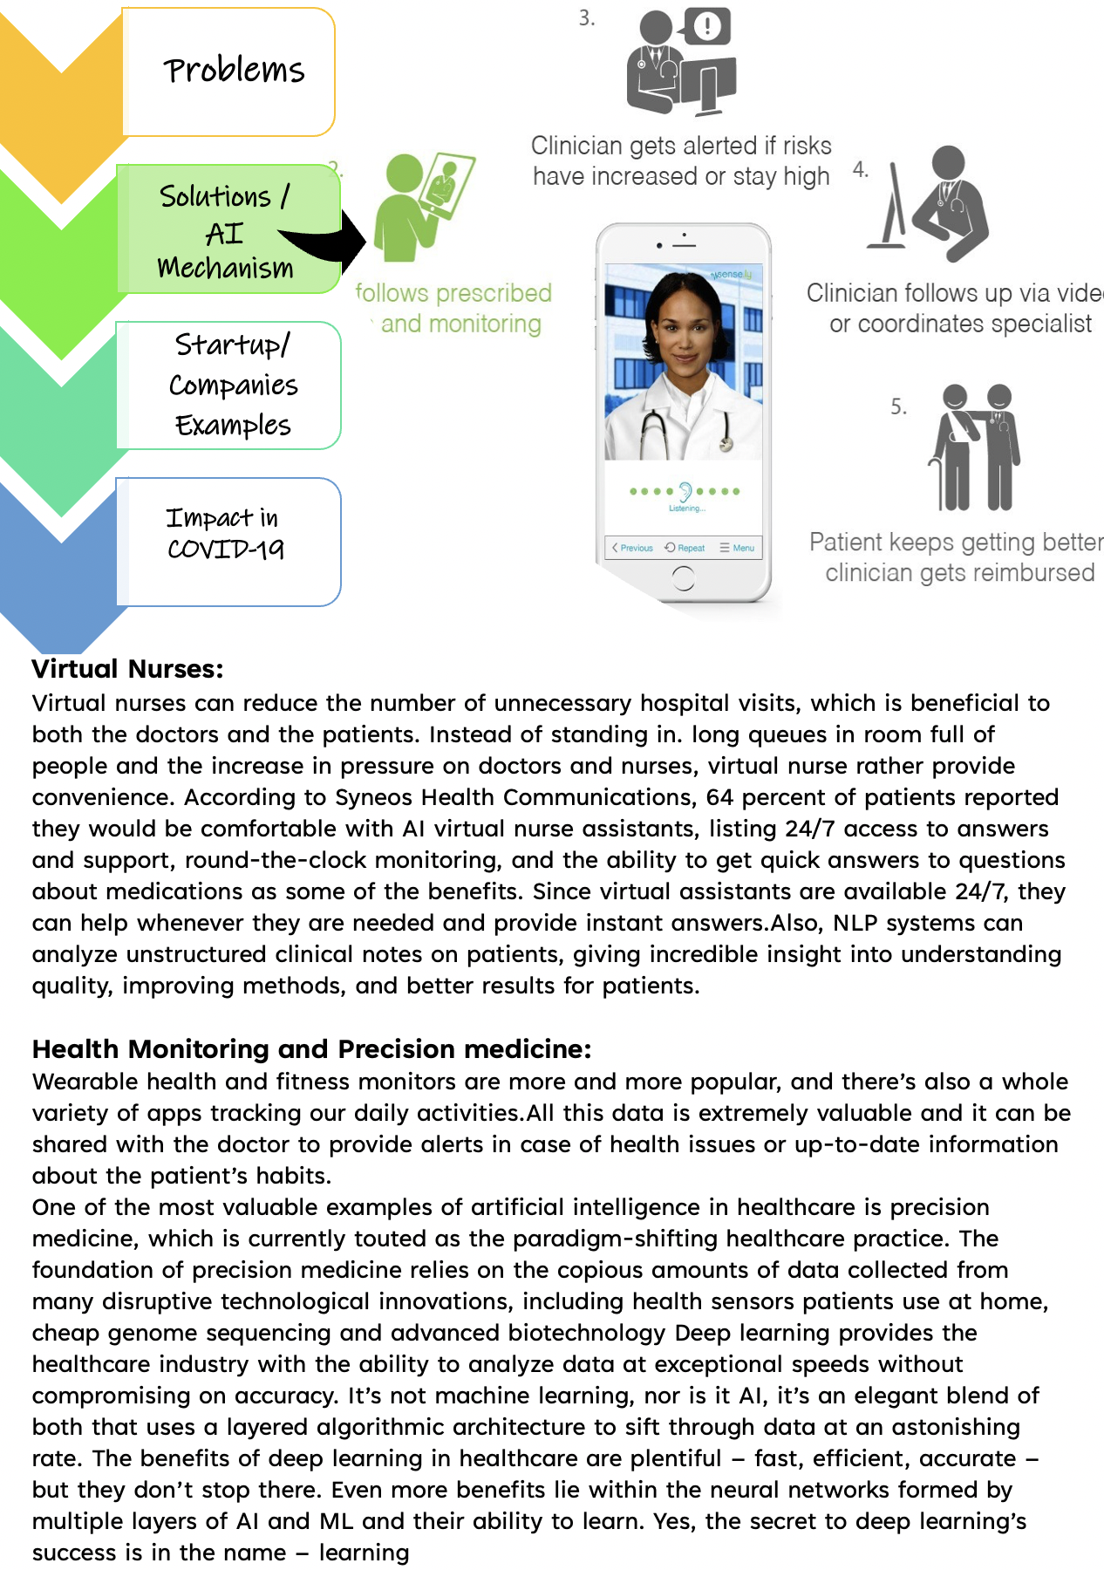

Slide 17
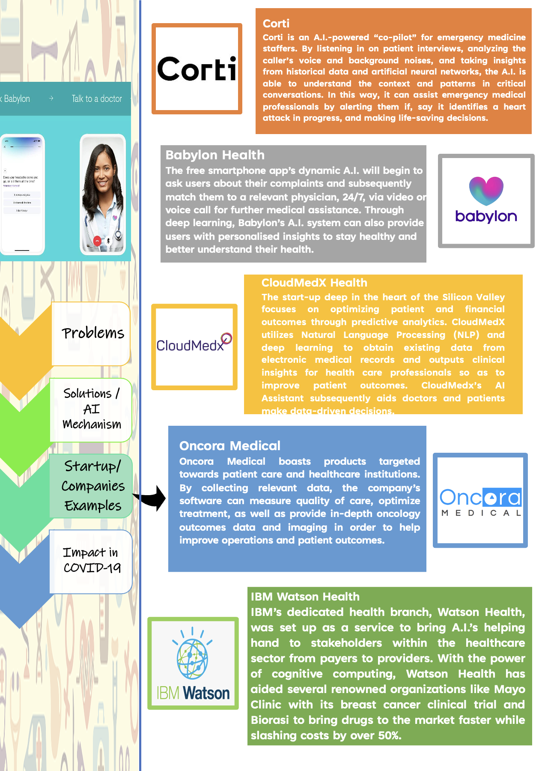

Slide 18
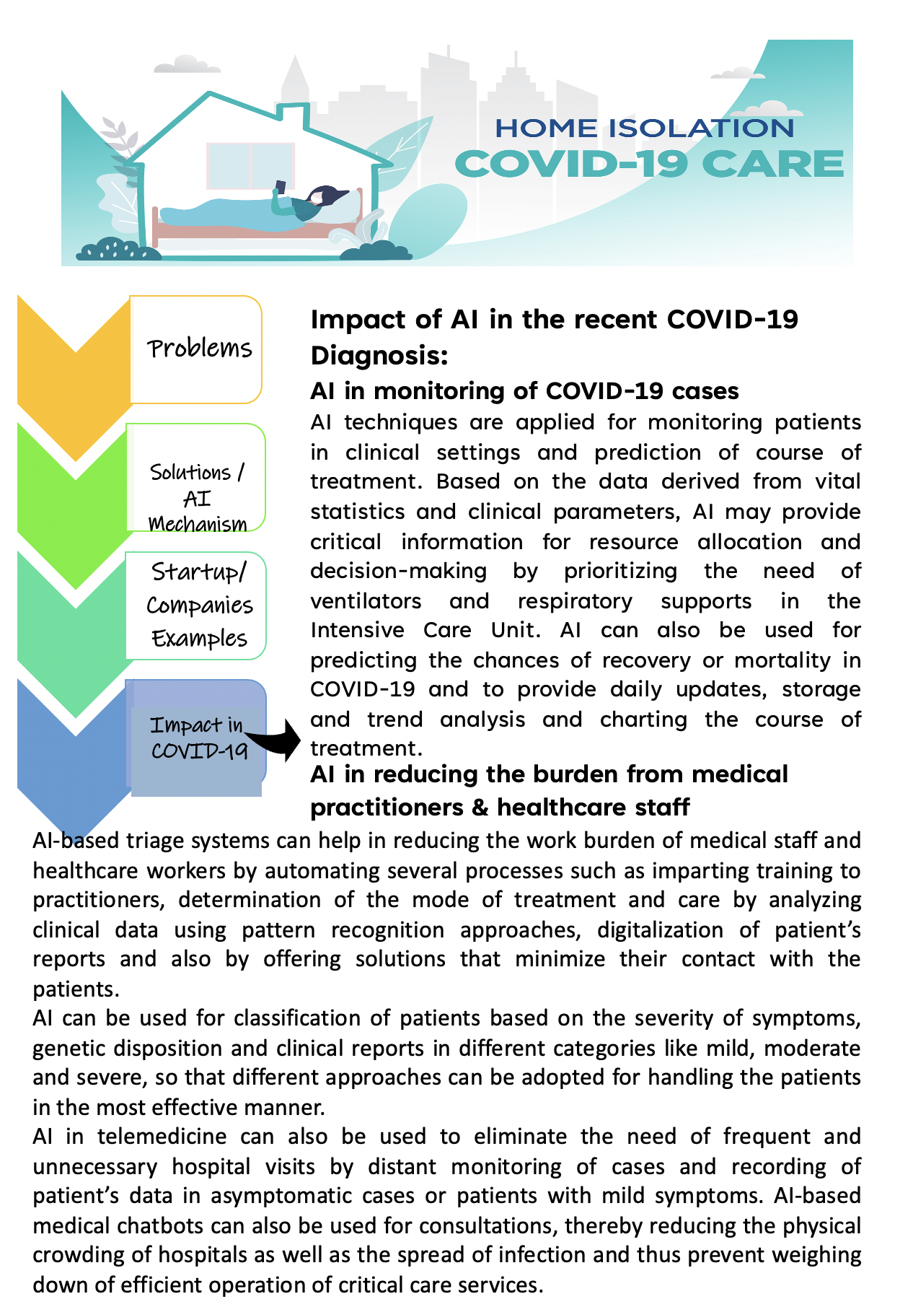

Slide 19
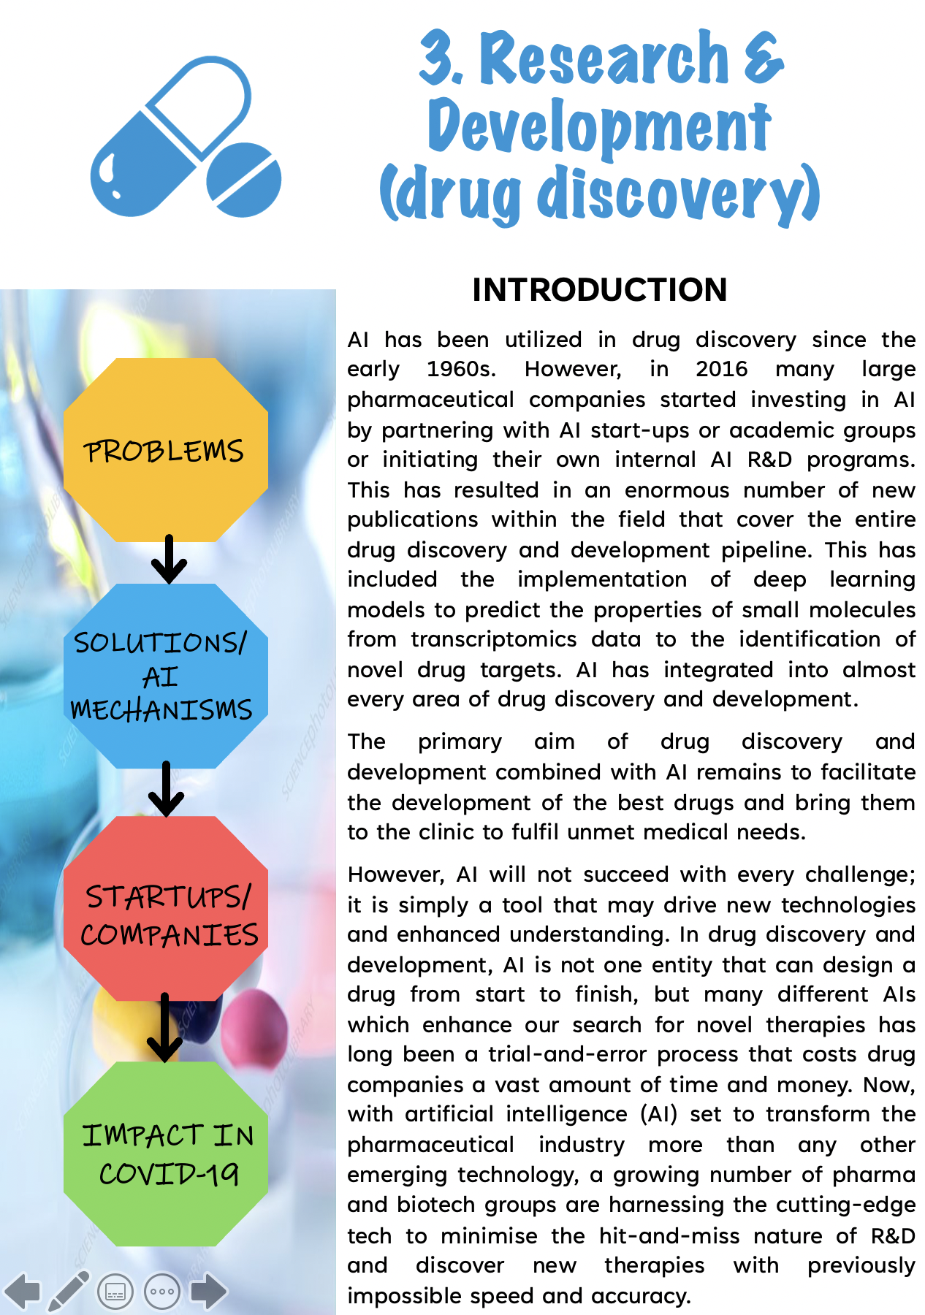

Slide 20
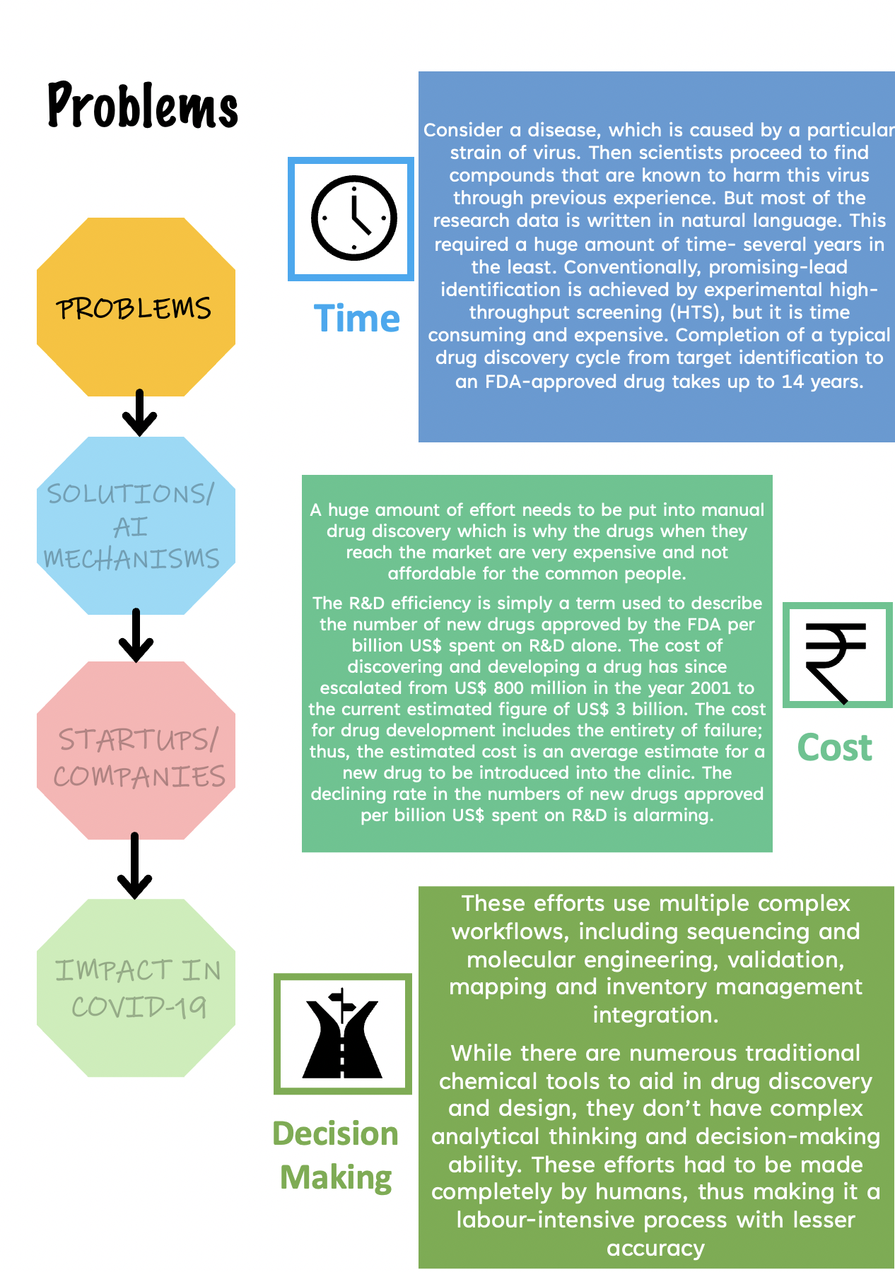

Slide 21
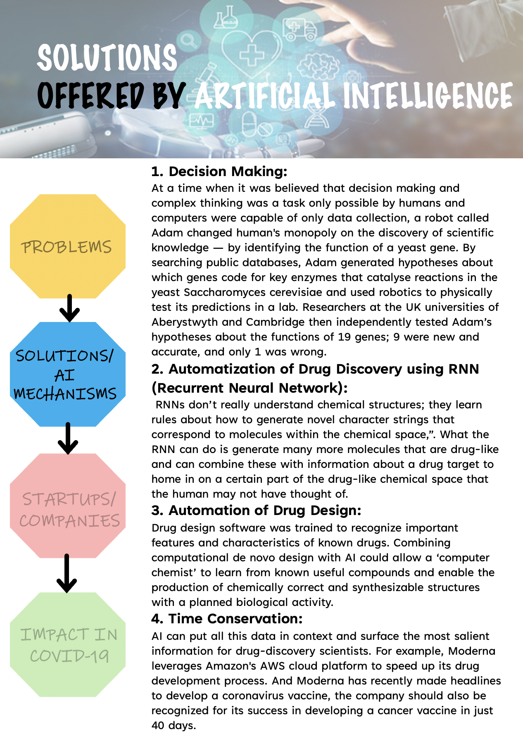

Slide 22
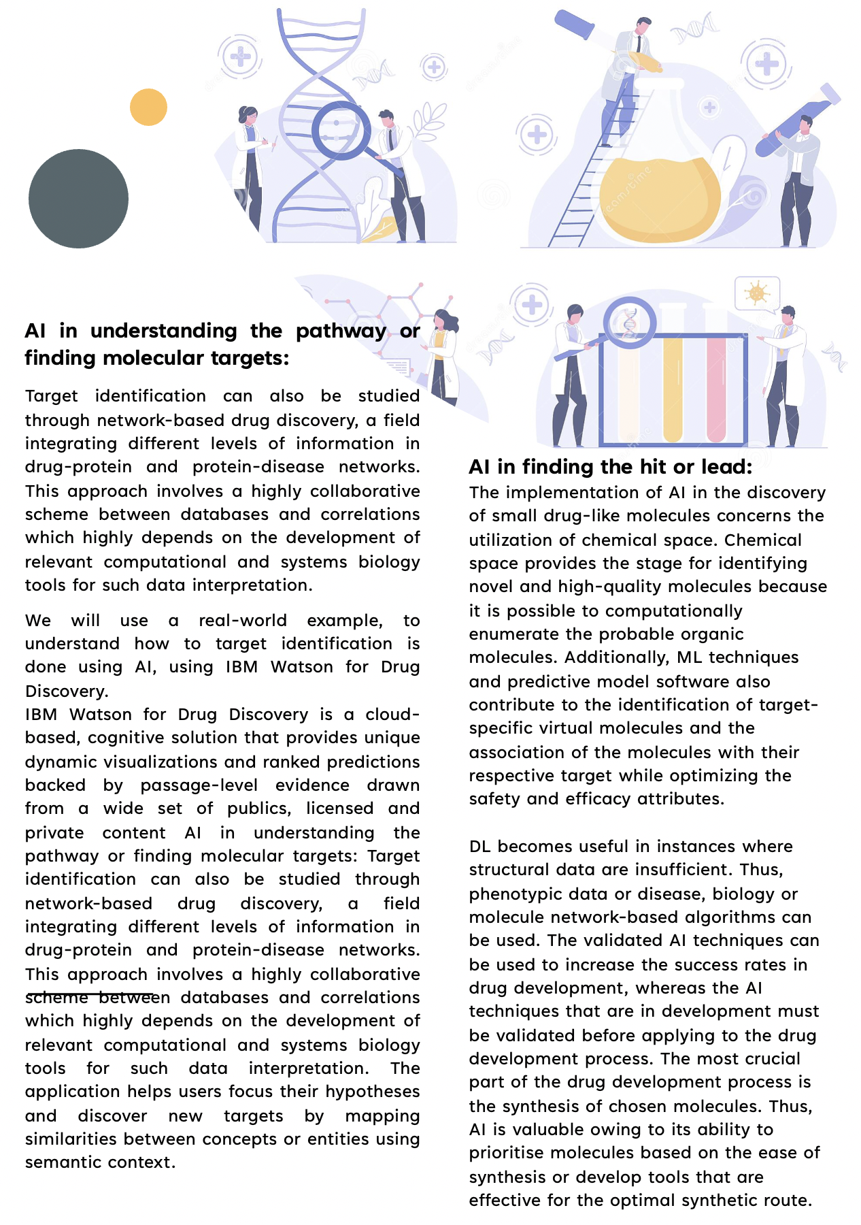

Slide 23
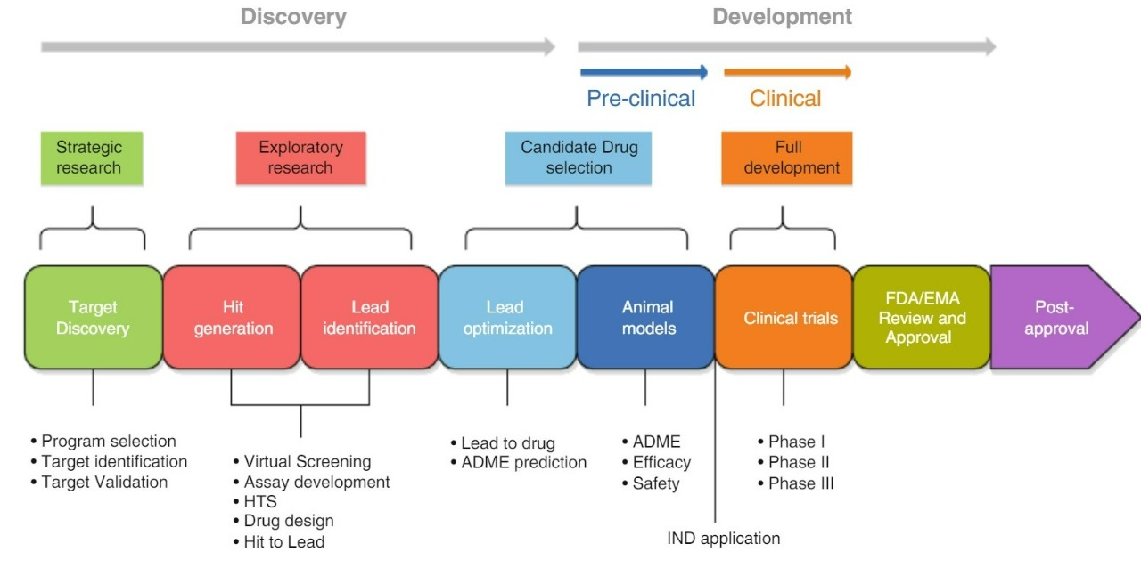
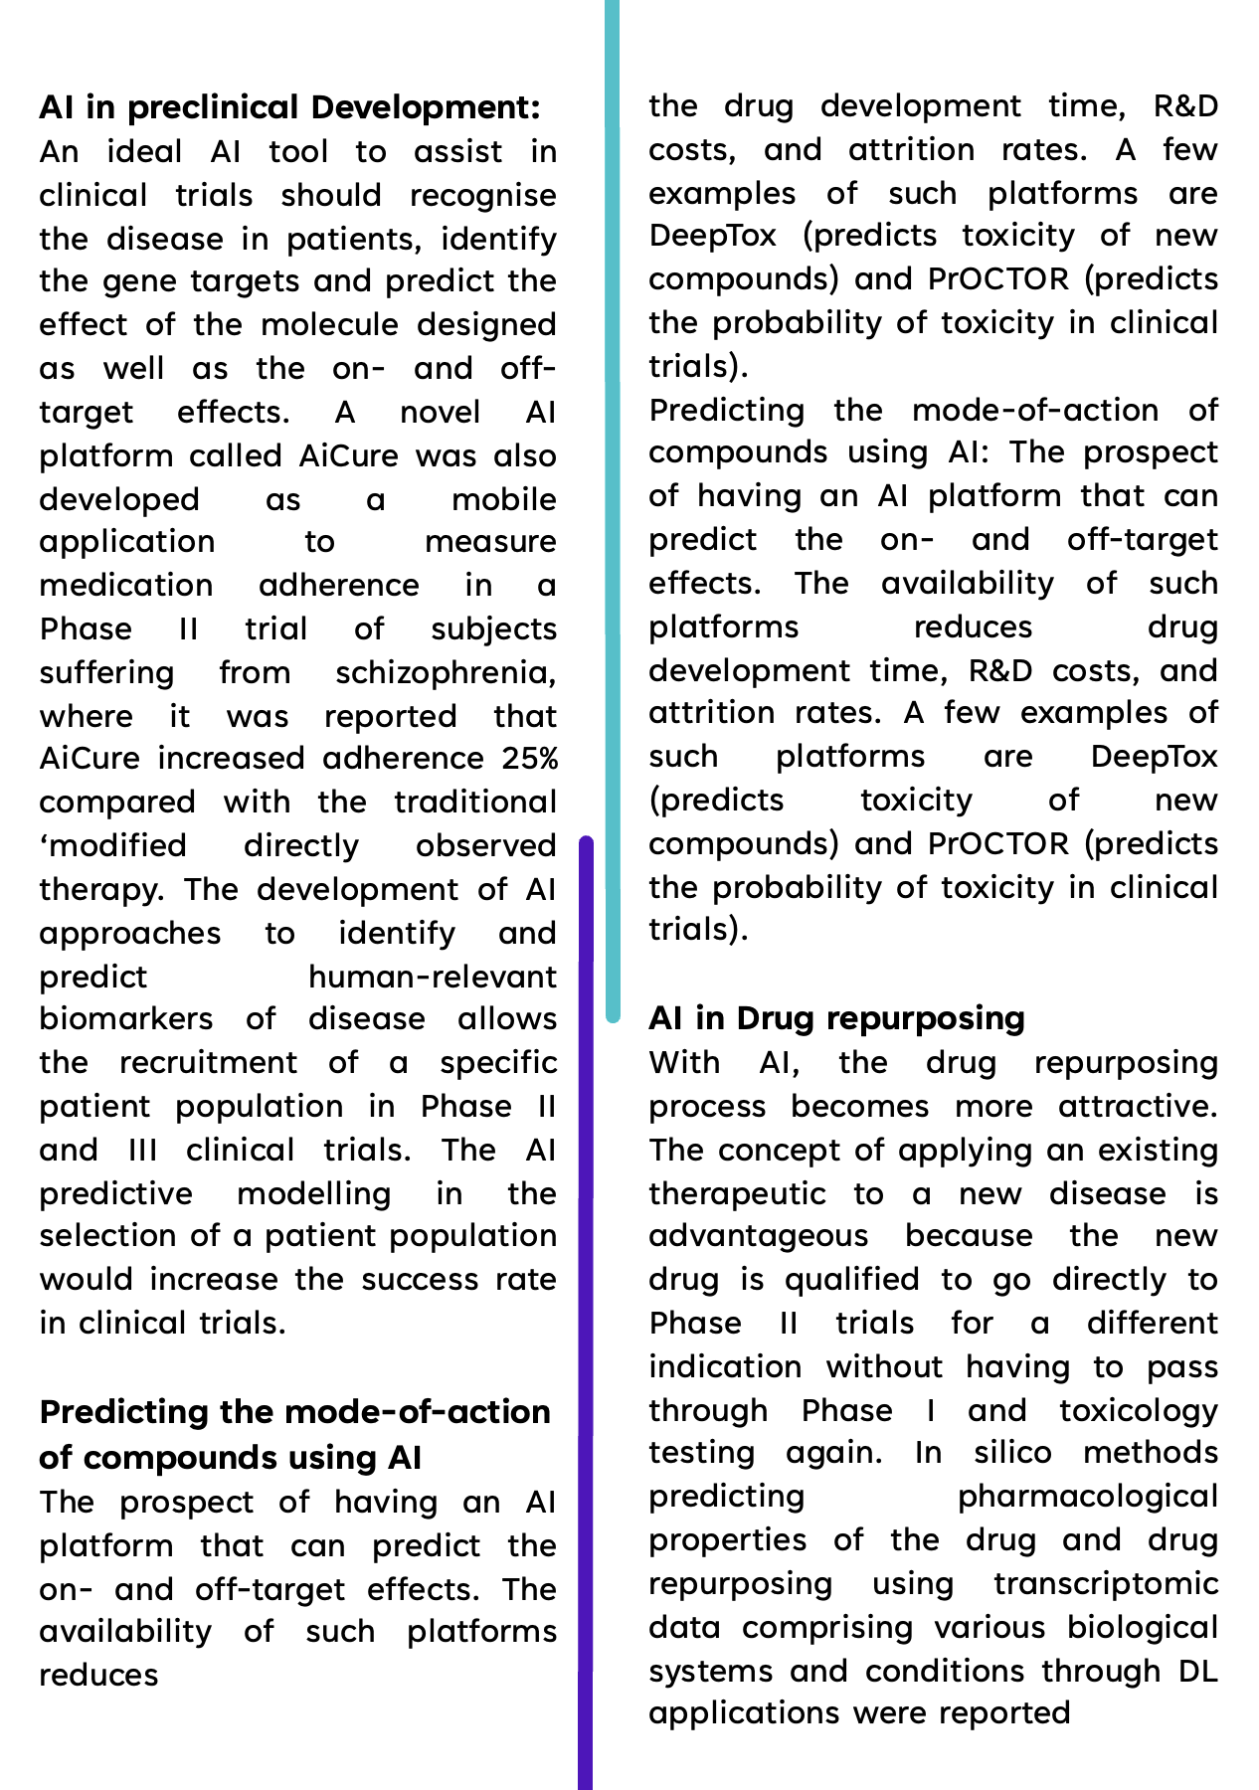

Slide 24
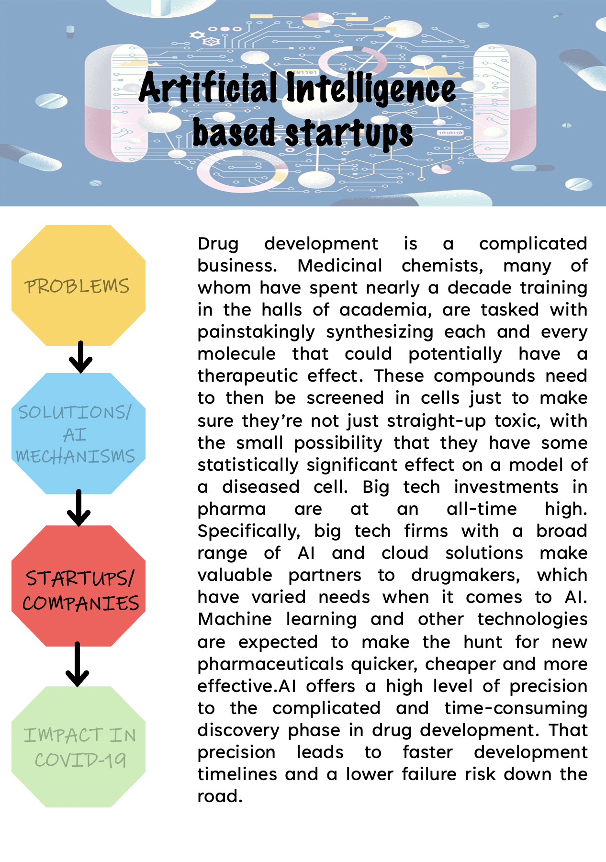

Slide 25
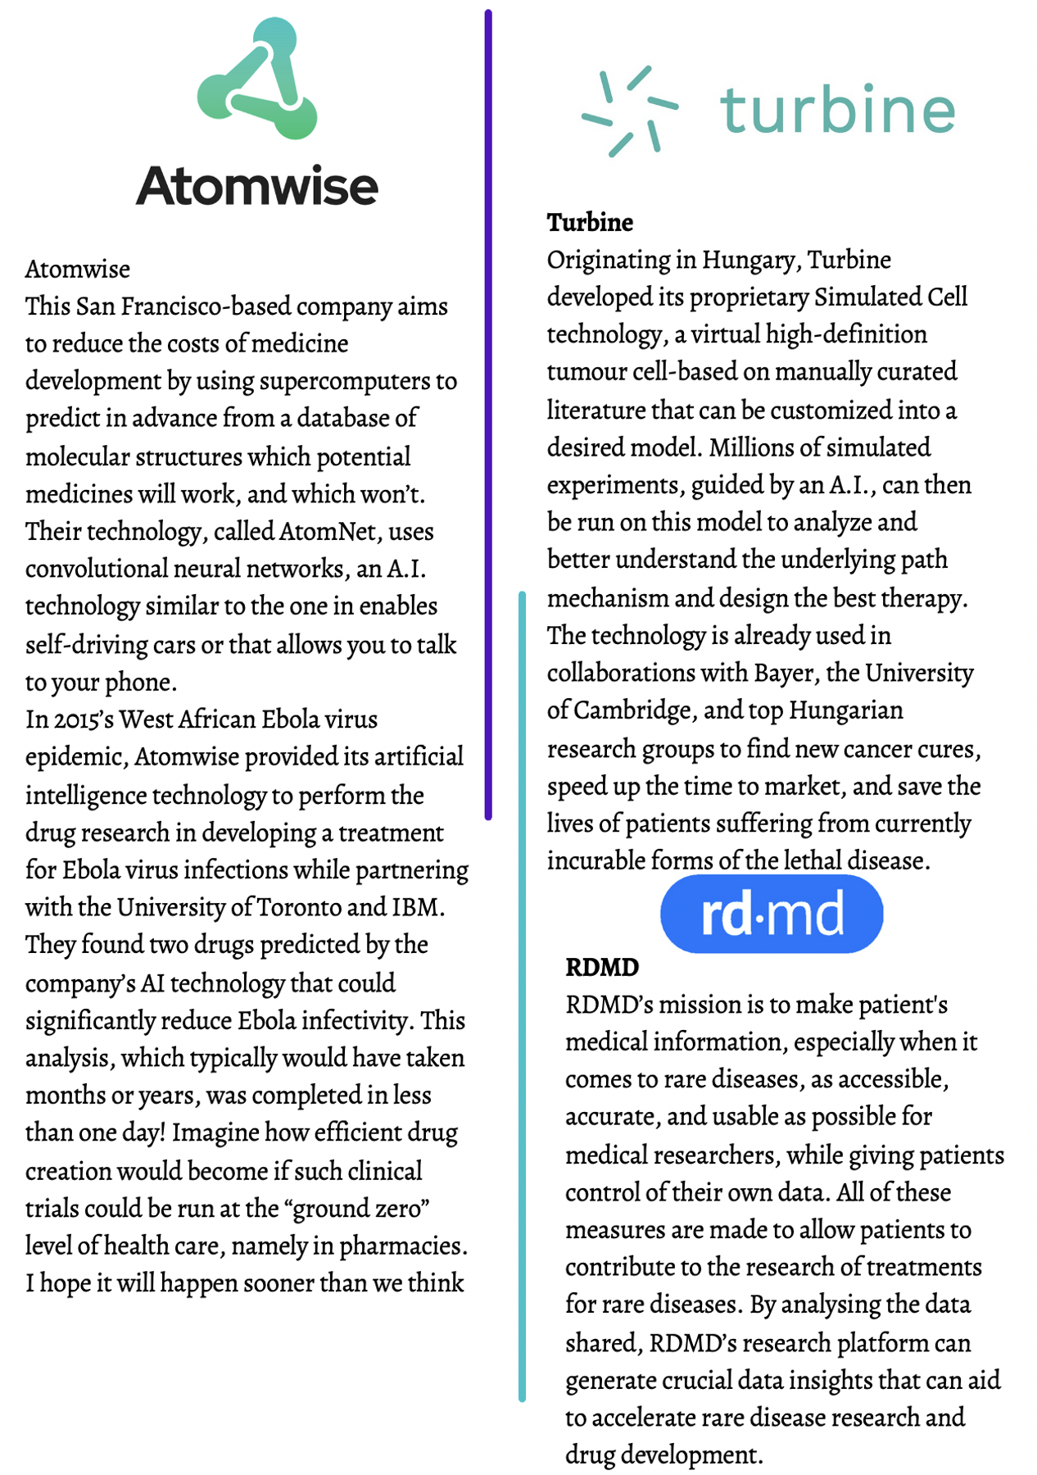

Slide 26
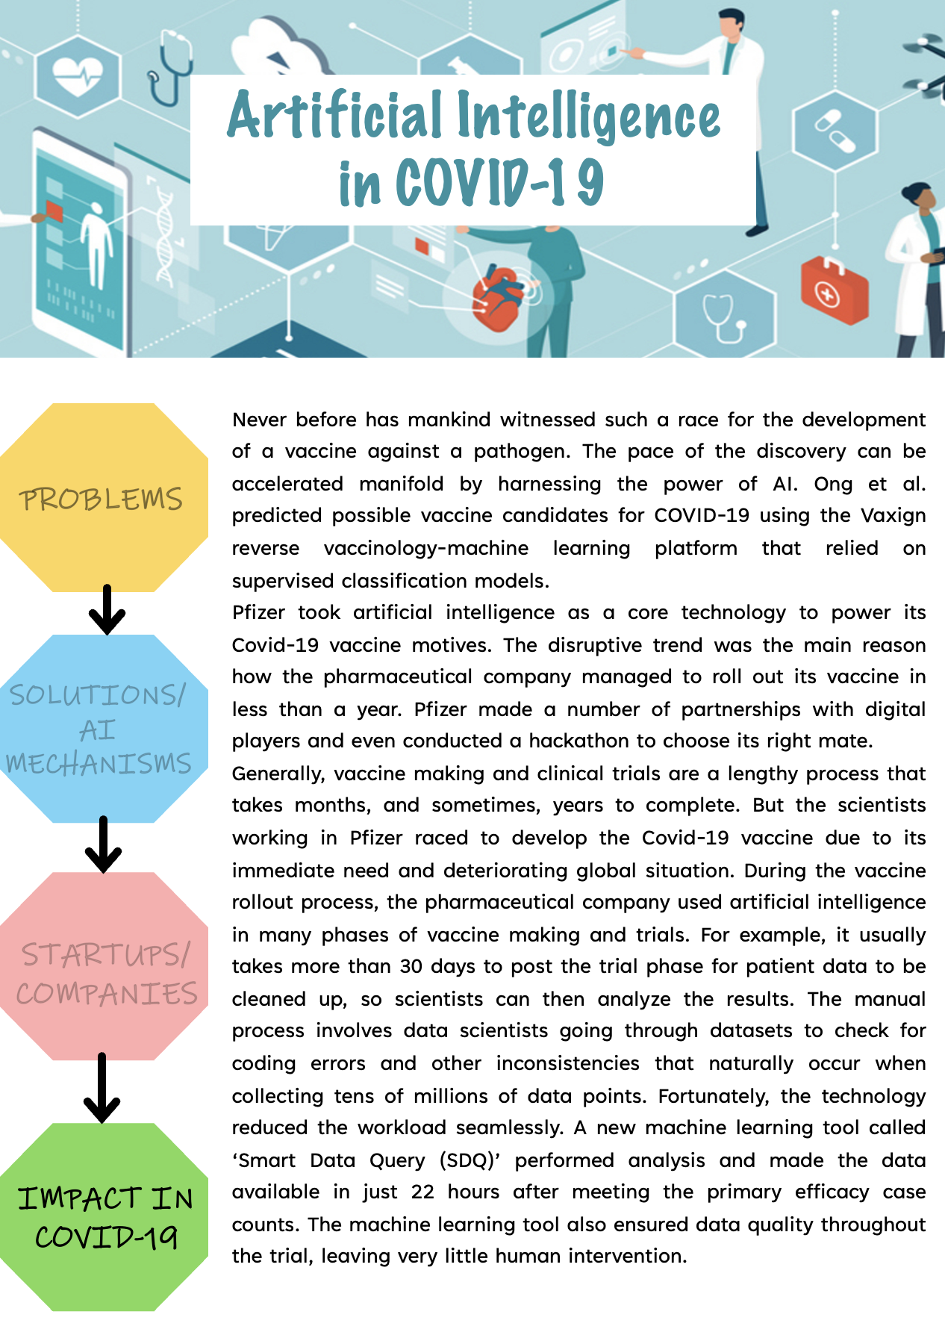

Slide 27
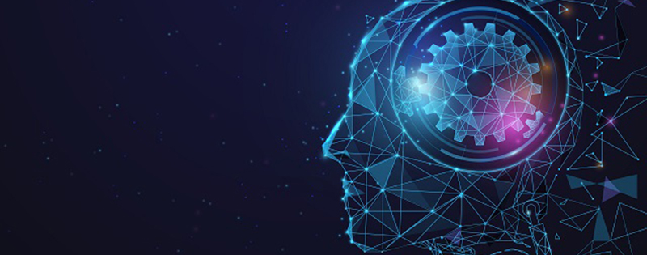
Conclusion
The healthcare industry is ripe for some major changes. From chronic diseases and cancer to radiology and risk assessment, there are nearly endless opportunities to leverage technology to deploy more precise, efficient, and impactful interventions at exactly the right moment in a patient’s care.
AI offers a number of advantages over traditional analytics and clinical decision-making techniques. Learning algorithms can become more precise and accurate as they interact with training data, allowing humans to gain unprecedented insights into diagnostics, care processes, treatment variability, and patient outcomes.
In Medical imaging data is one of the richest sources of information about patients, and often one of the most complex.
With megapixel upon megapixel of data packed into the results from X-rays, CAT scans, MRIs, and other testing modalities, combing through extremely high-resolution images can be challenging even for the most experienced clinical professional.
Artificial intelligence has already proven that it may be a valuable ally for radiologists and pathologists looking to accelerate their productivity and potentially improve their accuracy.
The aim of medical imaging is to capture abnormalities using image processing and machine learning techniques. Application areas can be divided into sub-branches such as the diagnosis of various diseases and medical operation planning. The top applications of AI-powered medical imaging are:

Slide 28
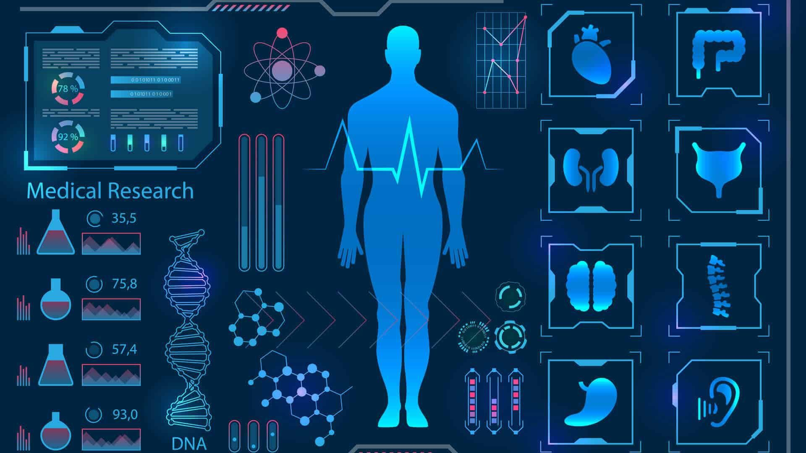
Revealing cardiovascular abnormalities
Prediction of Alzheimer’s disease
Cancer detection
Treatment revaluation
Surgical Planning
AI is increasingly helping to uncover hidden insights into clinical decision-making, connect patients with resources for self-management, and extract meaning from previously inaccessible, unstructured data assets.
Patient care and treatment: The complexity and rise of data in healthcare means that artificial intelligence (AI) will increasingly be applied within the field. Several types of AI are already being employed by payers and providers of care, and life sciences companies. The key categories of applications involve diagnosis and treatment recommendations, patient engagement and adherence, and administrative activities. Although there are many instances in which AI can perform healthcare tasks as well or better than humans, implementation factors will prevent large-scale automation of healthcare professional jobs for a considerable period. Ethical issues in the application of AI to healthcare are also discussed.
Physical robots are well known by this point, given that more than 200,000 industrial robots are installed each year around the world. They perform pre-defined tasks like lifting, repositioning, welding, or assembling objects in places like factories and warehouses and delivering supplies in hospitals. More recently, robots have become more collaborative with humans and are more easily trained by moving them through the desired task. They are also becoming more intelligent, as other AI capabilities are being embedded in their ‘brains’ (really their operating systems). Over time, it seems likely

Slide 29
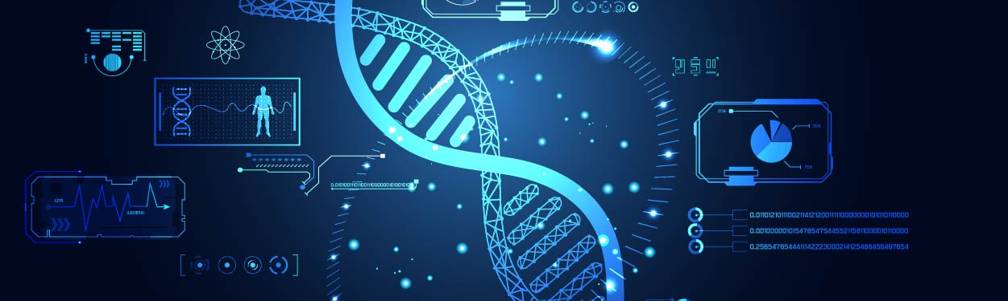
that the same improvements in intelligence that we have seen in other areas of AI would be incorporated into physical robots.
Surgical robots initially approved in the USA in 2000, provide ‘superpowers’ to surgeons, improving their ability to see, create precise and minimally invasive incisions, stitch wounds and so forth.6 Important decisions are still made by human surgeons, however. Common surgical procedures using robotic surgery include gynecologic surgery, prostate surgery and head and neck surgery.
We've described these technologies as individual ones, but increasingly they are being combined and integrated; robots are getting AI-based ‘brains’, image recognition is being integrated with RPA. Perhaps in the future these technologies will be so intermingled that composite solutions will be more likely or feasible.
In drug development: The boom of AI in the research and development sector began in 2016 when several large pharmaceutical companies started investing in AI. Since then, AI applications have expanded into almost every area of drug discovery and development. Today pharmaceutical companies are consistently investing in AI with the purpose of facilitating the development of the best drugs, minimising the hit-and-miss nature of R&D, and discovering new therapies with previously impossible speed and accuracy.
AI has the potential to correct several of the disadvantages of conventional drug development that are noted above. AI offers a high level of precision to the complicated and time-consuming discovery phase in drug development. That precision leads to faster development timelines and a lower failure risk down the road.
AI can contribute to Drug Design by recognizing important features and characteristics of known drugs, modelling target molecules and more.AI can

Slide 30

help in drug development through various ways, a major way being in understanding the pathway or finding molecular targets. A real-world application of such AI system is the IBM Watson for Drug Discovery Standard, which is a cloud computing solution designed to enable life science researchers to obtain insights into target identification and drug repurposing by analyzing millions of articles and other corpus data.
Another major application of AI in drug development is in finding the hit or lead.AI is used to for identify novel and high-quality molecules by computationally enumerating the probable organic molecules. Thus, AI systems can reduce the attrition rates and the R&D expenditure by decreasing the number of synthesized compounds that are tested.
The development of AI approaches to identify and predict human-relevant biomarkers of disease allows the recruitment of a specific patient population in Phase II and III clinical trials, thus increasing success rate of clinical trials. AI platforms can predict the on- and off-target effects and in vivo safety profile of compounds before they are synthesized, thus reducing drug development time, R&D costs and attrition rates.

Slide 31
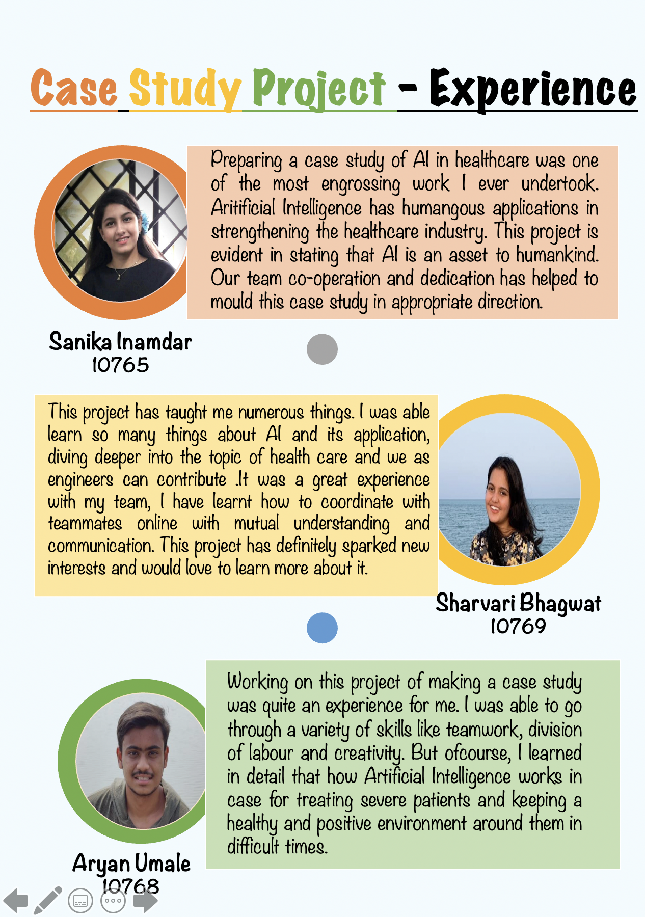

Slide 32
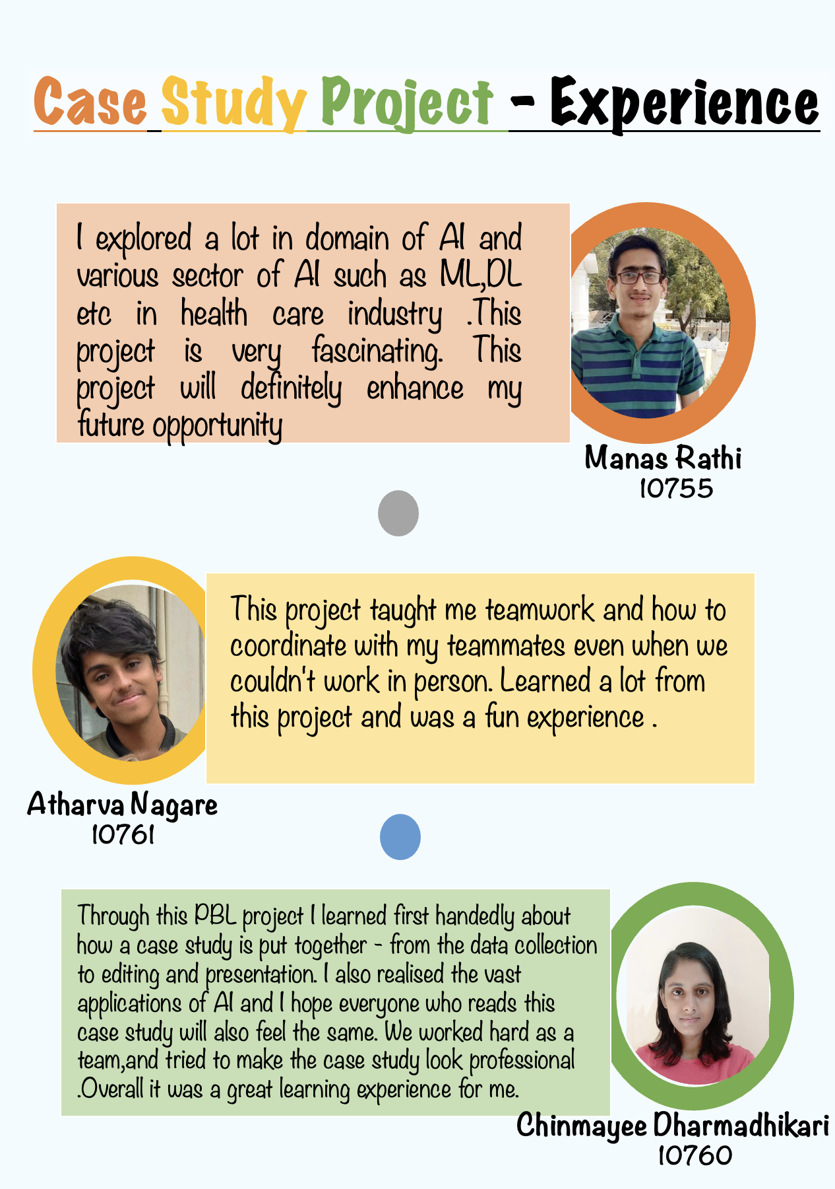

Slide 33

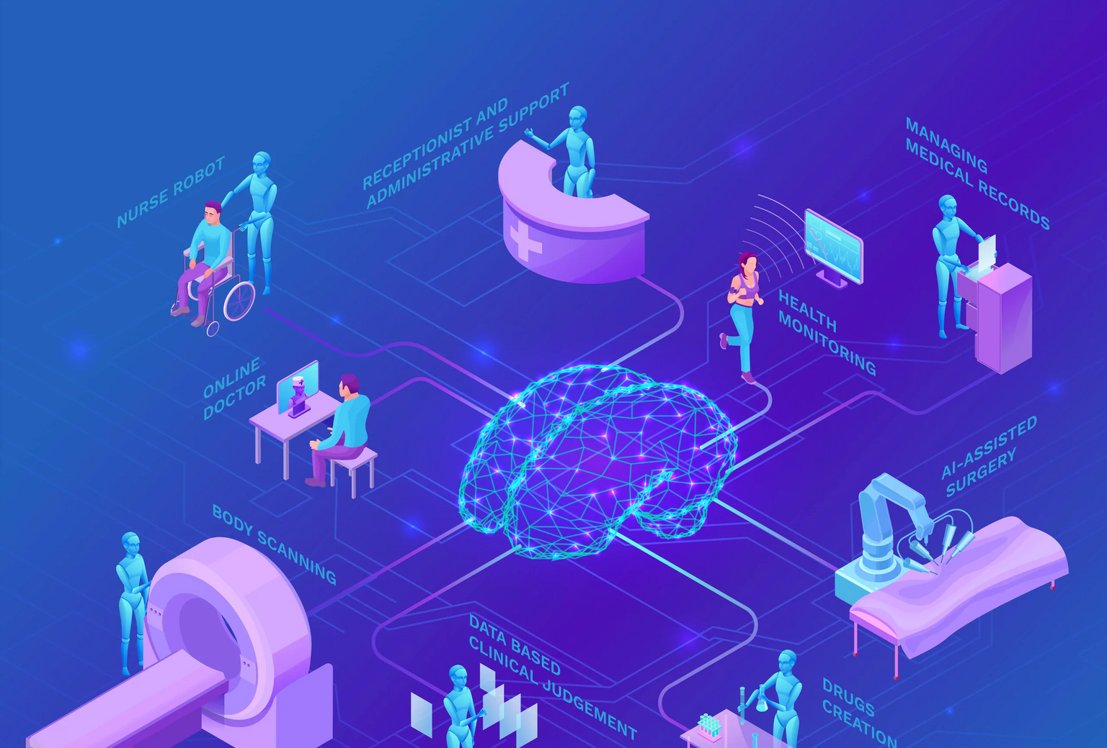
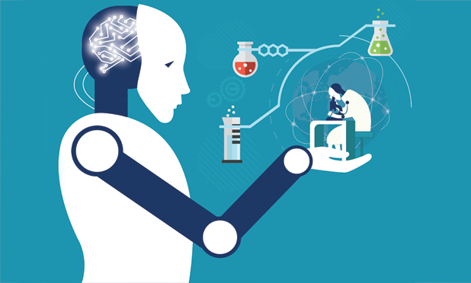
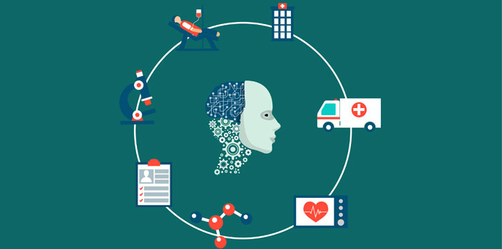
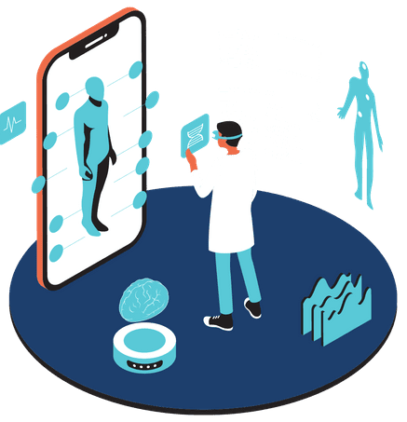
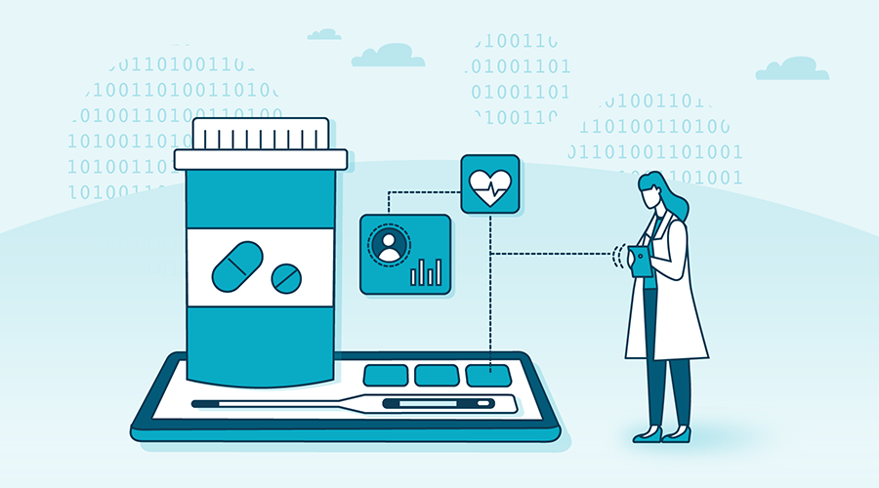
Thank you

